Slide 3
Testing Azure Infrastructure with Pester
Sam Cogan

Slide 4




Sam Cogan
Solution Architect – Willis Towers Watson
Microsoft Azure MVP
samcogan.com
@samcogan
sam-cogan

Slide 5
Why Testing?
We’re Writing Code Now!
Writing Code is Hard!
Because Developers are Judging Us!

Slide 6




Why Testing?
Reducing
Time
Cost
Downtime
Frustration

Slide 7
Pester The ubiquitous test and mock framework for PowerShell.

Slide 8
A Pester Test
Describe "Test Function X" {
Context “Test State/Functionality Y" {
It "does something useful" {
$true | Should Be $false
}
}
}

Slide 9



Test Types
Integration Test? Test of the whole script with data specific to deployment?
Syntax Test/Linting
Deployment Tests
Unit Tests

Slide 10
Text layout with bulleted text
Main topic: Segoe UI Semilight, size 28pt
Segoe UI, size 20pt for second level
Segoe UI, size 16pt for third level

Slide 11
Example with longer headline text wrapping to a second line
When the headline text is 2 lines, move this text block down to align to the lower blue guide
If you don’t see guidelines, click on the View menu, and then check the box in front of “Guides”
Use a “soft return” Shift + Enter to wrap text without adding extra line spacing

Slide 12
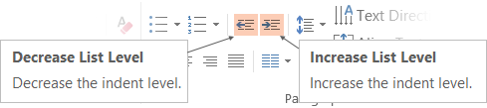
Adjusting list levels
Main topic: Segoe UI Semilight, size 28pt
Segoe UI, size 20pt for second level
Segoe UI, size 16pt for third level
Use the “Decrease List Level” and “Increase List Level” tools on the Home menu to change text levels.
Try this:
Place your cursor in the line of text that says “Segoe UI, size 20pt for second level”
Next click the Home tab, and then on the “Decrease List level” tool. Notice how the line moves up one level.
Now try placing your cursor in one of the top “Main topic…” line of text. Click the “Increase List Level” tool and see how the text is pushed in one level.
Use these 2 tools to adjust your text levels as you work

Slide 13
Bullet points layout with subtitle Set the subtitle to 20pt in the same text block, with character spacing Normal
Move the text block down vertically to align to lower guide
If you don’t see guidelines, click on the View menu, and then check the box in front of “Guides”
Hyperlink style: www.microsoft.com

Slide 14
Square photo with title
Smaller text

Slide 15
Square photo layout with smaller text

Slide 16
Slide palette info
The PowerPoint palette for this template has been built for you and is shown below.
Avoid using too many colors in your presentation.
PowerPoint Theme Accent colors
Accent 1
Accent 2
Accent 3
Accent 4
Accent 5
Accent 6
Use Accent 1 as the main accent color.
Use Accent 2 and Accent 3 only when additional colors are needed.
Use Accents 4-6 sparingly

Slide 17
Attention: PLEASE READ
Photography and copyright infringement.
Using imagery from movies, television, music and pop-culture is illegal, unless purchased, licensed or by express written consent from the owner. Please do not include unlicensed imagery in your presentation.
Sessions with questionable imagery will not be published until resolved. The speaker will be contacted via email for immediate resolution. If additional costs are incurred in editing, an I/O Code will be required.
If you have any questions regarding your imagery please contact Media Acquisitions
Music Sound Video Acquisitions: MuSoVidAcq@microsoft.com
The PPT deck and Recording will not be published until the editing is complete.

Slide 18
Common copyright myths
If an image is on the Internet/Bing it is in the public domain.
If there is no copyright notice on the image, I don’t need permission.
If I don’t profit from the use, I don’t need permission.
If I remove the image after notice, I don’t owe any money to the copyright.
If I alter the image a certain percentage, I don’t need permission.
If I only use a part of the image, I don’t need permission.
If I only include a hyperlink in my presentation and click it to show the image, I don’t need permission.

Slide 19
Resources for Microsoft employees
A few great places for imagery and information
Brand Central: A resource for information on the Microsoft brand
https://microsoft.sharepoint.com/teams/BrandCentral/
Microsoft News Center A great place for the latest and greatest
www.microsoft.com/en-us/news
Xbox Wire Media Assets library
http://news.xbox.com/media/
Featured Devices: PC, tablet and phone hardware imagery and marketing materials
https://www.featureddevices.com/
Presentation Resources: Presentation guidelines and PowerPoint templates
https://microsoft.sharepoint.com/teams/BrandCentral/Pages/Presentations.aspx
Respect intellectual property rights
Photography and graphics used in presentations, for both internal and external audiences, must be owned by Microsoft or licensed appropriately.
Microsoft has agreements in place with several stock providers. Contact Media Acquisitions for more information.
Media Acquisitions
www.superstock.com/
www.gettyimages.com/creativeimages/royaltyfree
Avoid intellectual property theft: Do not use photos or graphics copied from the web in presentations. When in doubt, consult with CELA.

Slide 20
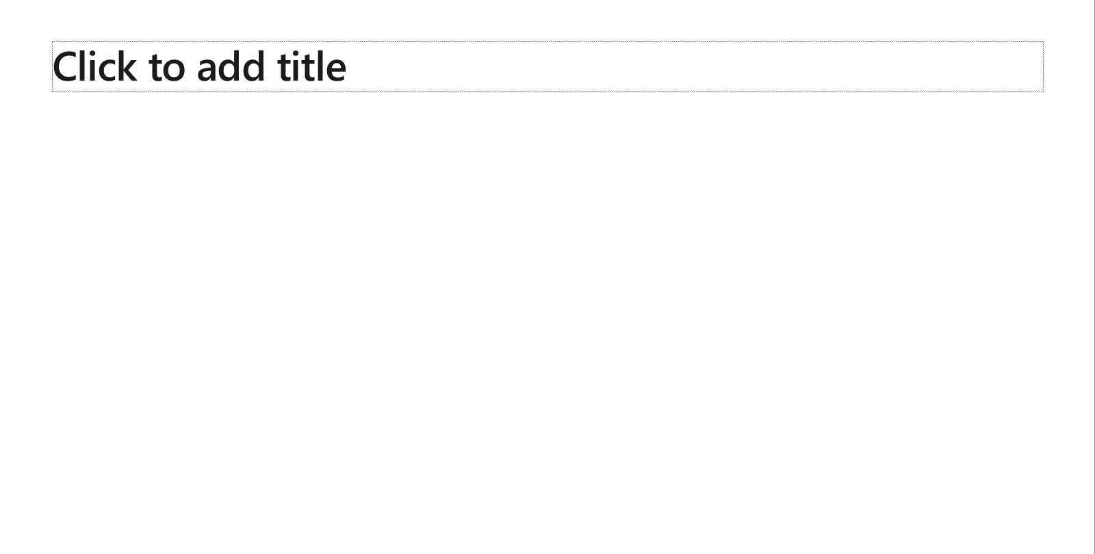
Creating accessible content
Take the following steps to create accessible content that everyone can consume effectively.
Contrast
Use high contrast colors for maximum readability
The recommended contrast ratio is at least 4.5:1
Shape and color
Use different shapes with a legend to indicate statuses to accommodate for color blindness
Example:
Alt text
Alt text helps people with screen readers understand the content of slides
You can create alternative text for shapes, pictures, charts, tables, SmartArt graphics, or other objects
Here’s how:
Right click the image or shape
Select Format Picture… or Format Shape…
Select the Size & Properties icon
Expand the Alt Text field
Enter a Title and Description of your image or object
Slide layouts
Using a built-in slide layout that matches your content ensures a hierarchical reading order of text blocks
Example:
If a new slide will have a title, rather than starting with a blank layout and adding a text block for the title, choose one of the built-in layouts with a title placeholder
Reading order
Screen readers describe content on the screen in the order it was created
To ensure your content is read back in the order you prefer, arrange your objects in the Selection Pane appropriately. Objects on the bottom of the selection pane are read first
Here’s how:
Click the Home tab
In the Drawing group, select the Arrange drop-down menu
Click Selection Pane…
Text
Text
Text
Subject 1
Subject 2
Subject 3
Color Contrast Analyzer
Download this tool to determine the legibility of text and the contrast of visual elements
Download
C1
C2
C3
Additional tips
Be sure to run the Accessibility Checker! Go to File click the Check for Issues drop down menu click Check Accessibility
Videos need to be accessible: If your presentation includes a video, ensure it is captioned and audio described (if appropriate)
Visit the Office Accessibility Center to learn more about accessibility in PowerPoint

Slide 21

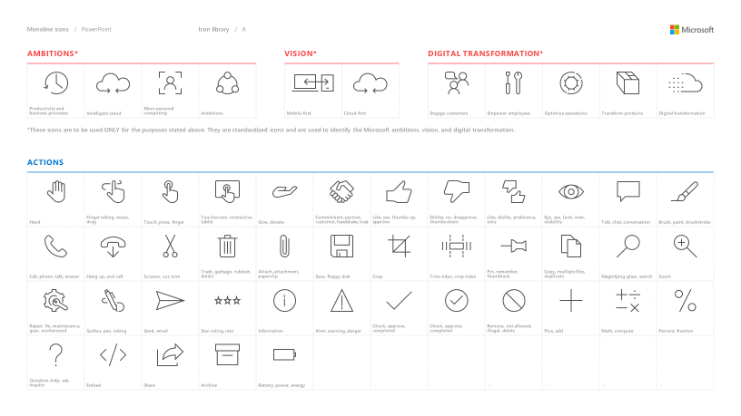
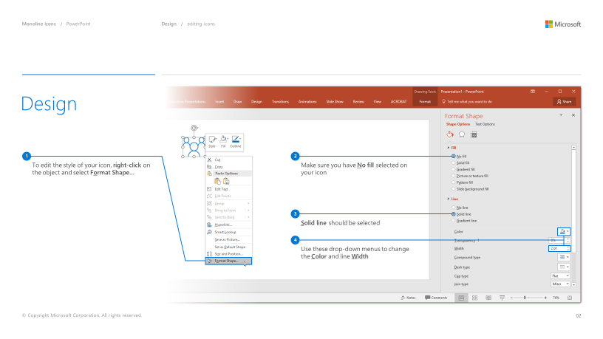
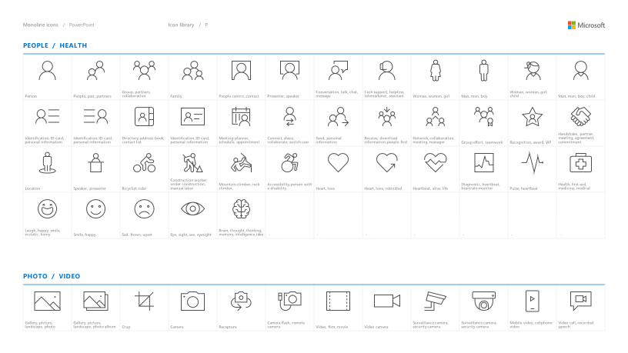
Microsoft monoline icons
Looking for icon resources?
The Monoline icon library for PowerPoint is a slide deck that provides a library of icons for use in PowerPoint presentations.
The Monoline icon style guide for PowerPoint is a pdf with additional guidelines.
Download both from Brand Central.

Slide 22
Demo
Speaker name

Slide 23
Software code slide

Slide 24
Notes (hidden)
Some speakers at Microsoft like to use this slide for hidden “notes slides”.
Delete it if you don’t want to use it.
NEXT: <next slide title>

Slide 27
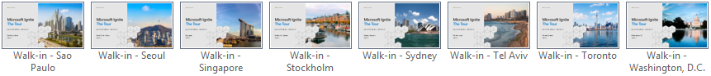
City-specific walk-in slides
This template contains specific walk-in slides for each city visited by the Ignite Tour.
To choose the correct walk-in slide:
Go to the Home tab.
Click the down arrow next to New Slide.
Scroll down on the list of available layouts and choose the layout that matches the desired city; for example, the layout called “Walkin - Amsterdam” if your presentation is to be given in Amsterdam.
If you’d like to keep the file size down once you have selected your city walk-in, you can go into the master and delete the walk-in slide masters you are not using. Go to the “View” tab, click on “Slide master,” 6 options from the left, navigate to the master walk-ins, select the masters you are not using, and hit delete.

Slide 28
Presentation title
Subtitle or speaker name

Slide 29
Text layout (without bullet points)
Main topic: Segoe UI Semilight, size 28pt
Segoe UI, size 20pt for second level
Segoe UI, size 16pt for third level

Slide 30
Text layout with bulleted text
Main topic: Segoe UI Semilight, size 28pt
Segoe UI, size 20pt for second level
Segoe UI, size 16pt for third level

Slide 31
Example with longer headline text wrapping to a second line
When the headline text is 2 lines, move this text block down to align to the lower blue guide
If you don’t see guidelines, click on the View menu, and then check the box in front of “Guides”
Use a “soft return” Shift + Enter to wrap text without adding extra line spacing

Slide 32
Adjusting list levels
Main topic: Segoe UI Semilight, size 28pt
Segoe UI, size 20pt for second level
Segoe UI, size 16pt for third level
Use the “Decrease List Level” and “Increase List Level” tools on the Home menu to change text levels.
Try this:
Place your cursor in the line of text that says “Segoe UI, size 20pt for second level”
Next click the Home tab, and then on the “Decrease List level” tool. Notice how the line moves up one level.
Now try placing your cursor in one of the top “Main topic…” line of text. Click the “Increase List Level” tool and see how the text is pushed in one level.
Use these 2 tools to adjust your text levels as you work

Slide 33
Bullet points layout with subtitle Set the subtitle to 20pt in the same text block, with character spacing Normal
Move the text block down vertically to align to lower guide
If you don’t see guidelines, click on the View menu, and then check the box in front of “Guides”
Hyperlink style: www.microsoft.com

Slide 34
Square photo with title
Smaller text

Slide 35
Square photo layout with smaller text

Slide 36
Slide palette info
The PowerPoint palette for this template has been built for you and is shown below.
Avoid using too many colors in your presentation.
PowerPoint Theme Accent colors
Accent 1
Accent 2
Accent 3
Accent 4
Accent 5
Accent 6
Use Accent 1 as the main accent color.
Use Accent 2 and Accent 3 only when additional colors are needed.
Use Accents 4-6 sparingly

Slide 37
Attention: PLEASE READ
Photography and copyright infringement.
Using imagery from movies, television, music and pop-culture is illegal, unless purchased, licensed or by express written consent from the owner. Please do not include unlicensed imagery in your presentation.
Sessions with questionable imagery will not be published until resolved. The speaker will be contacted via email for immediate resolution. If additional costs are incurred in editing, an I/O Code will be required.
If you have any questions regarding your imagery please contact Media Acquisitions
Music Sound Video Acquisitions: MuSoVidAcq@microsoft.com
The PPT deck and Recording will not be published until the editing is complete.

Slide 38
Common copyright myths
If an image is on the Internet/Bing it is in the public domain.
If there is no copyright notice on the image, I don’t need permission.
If I don’t profit from the use, I don’t need permission.
If I remove the image after notice, I don’t owe any money to the copyright.
If I alter the image a certain percentage, I don’t need permission.
If I only use a part of the image, I don’t need permission.
If I only include a hyperlink in my presentation and click it to show the image, I don’t need permission.

Slide 39
Resources for Microsoft employees
A few great places for imagery and information
Brand Central: A resource for information on the Microsoft brand
https://microsoft.sharepoint.com/teams/BrandCentral/
Microsoft News Center A great place for the latest and greatest
www.microsoft.com/en-us/news
Xbox Wire Media Assets library
http://news.xbox.com/media/
Featured Devices: PC, tablet and phone hardware imagery and marketing materials
https://www.featureddevices.com/
Presentation Resources: Presentation guidelines and PowerPoint templates
https://microsoft.sharepoint.com/teams/BrandCentral/Pages/Presentations.aspx
Respect intellectual property rights
Photography and graphics used in presentations, for both internal and external audiences, must be owned by Microsoft or licensed appropriately.
Microsoft has agreements in place with several stock providers. Contact Media Acquisitions for more information.
Media Acquisitions
www.superstock.com/
www.gettyimages.com/creativeimages/royaltyfree
Avoid intellectual property theft: Do not use photos or graphics copied from the web in presentations. When in doubt, consult with CELA.

Slide 40
Creating accessible content
Take the following steps to create accessible content that everyone can consume effectively.
Contrast
Use high contrast colors for maximum readability
The recommended contrast ratio is at least 4.5:1
Shape and color
Use different shapes with a legend to indicate statuses to accommodate for color blindness
Example:
Alt text
Alt text helps people with screen readers understand the content of slides
You can create alternative text for shapes, pictures, charts, tables, SmartArt graphics, or other objects
Here’s how:
Right click the image or shape
Select Format Picture… or Format Shape…
Select the Size & Properties icon
Expand the Alt Text field
Enter a Title and Description of your image or object
Slide layouts
Using a built-in slide layout that matches your content ensures a hierarchical reading order of text blocks
Example:
If a new slide will have a title, rather than starting with a blank layout and adding a text block for the title, choose one of the built-in layouts with a title placeholder
Reading order
Screen readers describe content on the screen in the order it was created
To ensure your content is read back in the order you prefer, arrange your objects in the Selection Pane appropriately. Objects on the bottom of the selection pane are read first
Here’s how:
Click the Home tab
In the Drawing group, select the Arrange drop-down menu
Click Selection Pane…
Text
Text
Text
Subject 1
Subject 2
Subject 3
Color Contrast Analyzer
Download this tool to determine the legibility of text and the contrast of visual elements
Download
C1
C2
C3
Additional tips
Be sure to run the Accessibility Checker! Go to File click the Check for Issues drop down menu click Check Accessibility
Videos need to be accessible: If your presentation includes a video, ensure it is captioned and audio described (if appropriate)
Visit the Office Accessibility Center to learn more about accessibility in PowerPoint

Slide 41
Microsoft monoline icons
Looking for icon resources?
The Monoline icon library for PowerPoint is a slide deck that provides a library of icons for use in PowerPoint presentations.
The Monoline icon style guide for PowerPoint is a pdf with additional guidelines.
Download both from Brand Central.

Slide 42
Demo
Speaker name

Slide 43
Video

Slide 44
Section title

Slide 45
Software code slide
This slide layout uses Consolas, a monotype font which is ideal for showing software code.

Slide 46
Notes (hidden)
Some speakers at Microsoft like to use this slide for hidden “notes slides”.
Delete it if you don’t want to use it.
NEXT: <next slide title>

